Slide 1

Lifestyle Medicine residency curriculum
At the
Virginia Tech Carilion – Carilion Clinic
Family Medicine Residency
Notes:
Hello and welcome from all of us at VTC-Carilion Family Medicine Residency! We are so glad you are interested in our program and are excited to share with you more about our Lifestyle Medicine curriculum.

Slide 2
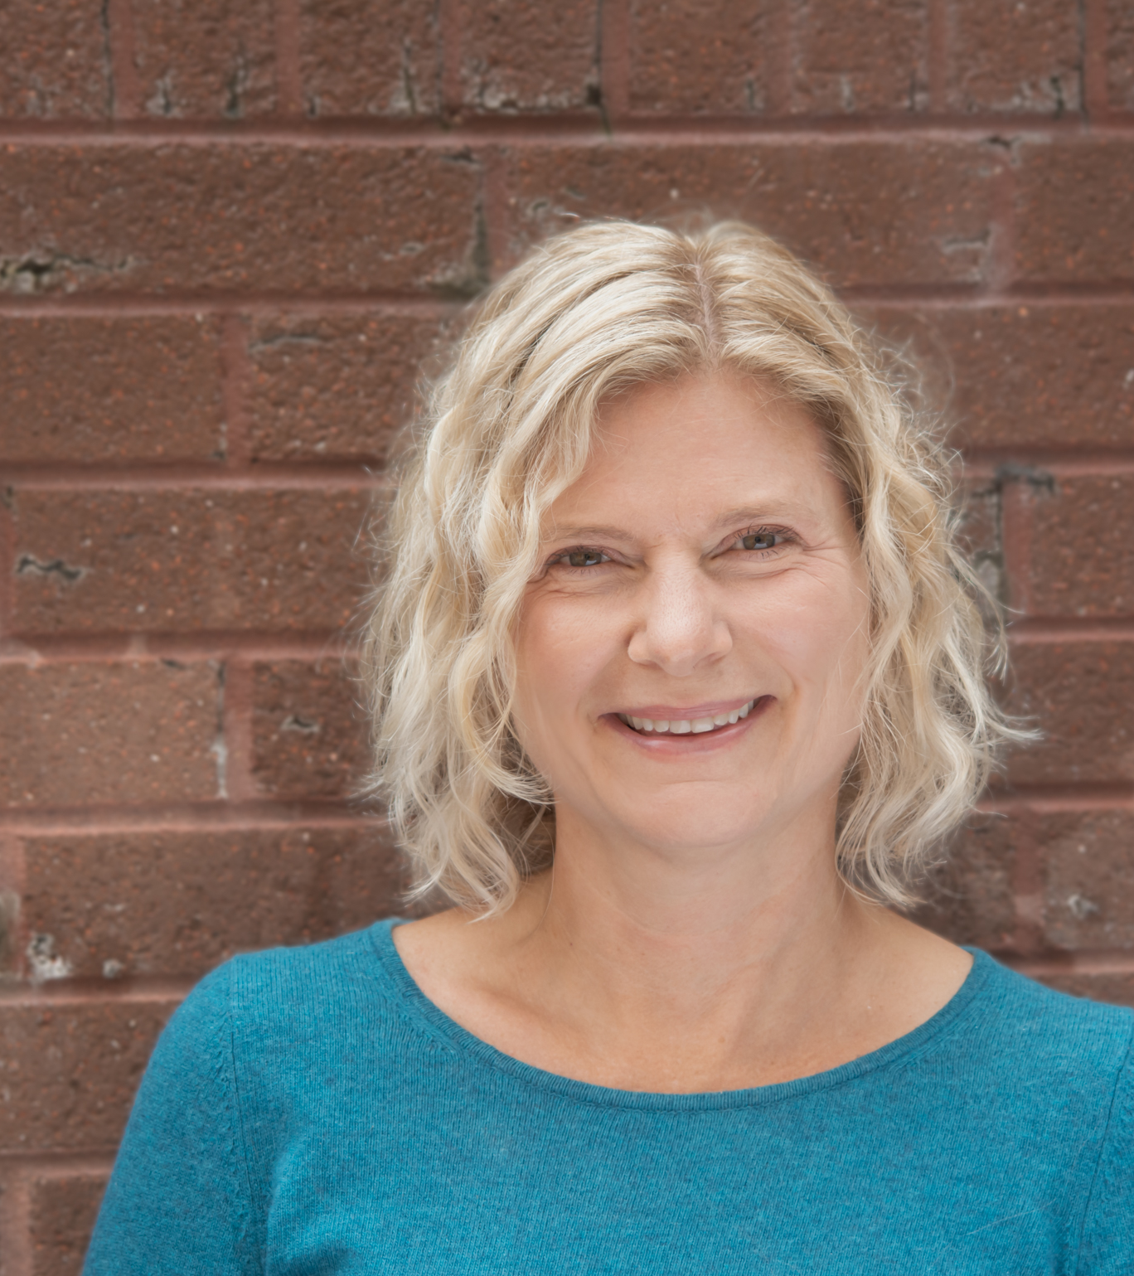
Beth Polk, MD
Board certified in Lifestyle Medicine since 2017
Over 25 years in clinical practice
Graduate of the Carilion Family Medicine Program
Notes:
My name is Beth Polk, and I am the faculty coordinator for the Lifestyle Medicine program. I am a graduate of this residency program and have practiced with Carilion for the past 25 years. I became board certified in Lifestyle Medicine through the American Board of Lifestyle Medicine in 2017 and have been actively incorporating it into my practice since then. I joined the residency program in May of 2022 to start a Lifestyle Medicine focused practice and help start the Lifestyle Medicine residency curriculum along with my faculty colleagues.

Slide 3
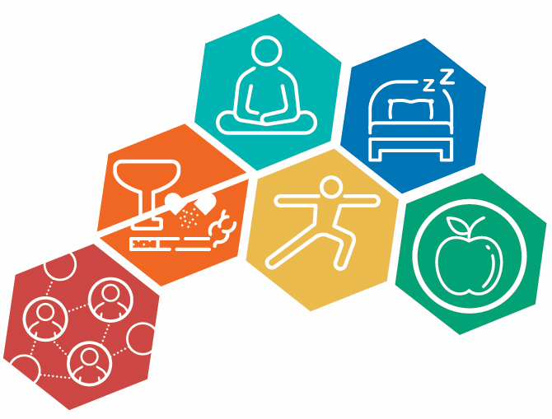

Notes:
As defined by the American College of Lifestyle Medicine (ACLM): Lifestyle Medicine is the use of evidence-based lifestyle therapeutic interventions to prevent, treat, and often reverse chronic disease.
This is done by focusing on including a whole-food, plant-predominant eating pattern, regular physical activity, restorative sleep, stress management, avoidance of risky substances, and positive social connection.

Slide 4
Lifestyle medicine track
Curriculum integrated into the overall residency curriculum
Residents who complete the track will be eligible to sit for the Lifestyle Medicine boards upon completion of residency
Dedicated core group of faculty trained in Lifestyle Medicine
Dedicated time is give on the Lifestyle Medicine elective to complete requirements
Highlights
Notes:
We have integrated the Lifestyle Medicine Residency Curriculum (the LMRC) into our overall residency curriculum as the Lifestyle Medicine Track. All residents in the program have access to the content, and those who chose to join the Lifestyle Medicine Track will be eligible to sit for the Lifestyle Medicine boards upon completion of residency. We have a dedicated core group of faculty who are trained in Lifestyle Medicine and are engaged in teaching, and all of our faculty participate in incorporating Lifestyle Medicine as part of clinic precepting. Residents on the track will have dedicated time while on the Lifestyle Medicine elective to complete their requirements.

Slide 5
LMRC
The curriculum is a mix of
  Didactic lectures
  Online modules
  Individual and group application activities
  Group participation/facilitation
  Engagement with an Intensive Therapeutic Lifestyle Change program
For more information:
https://lifestylemedicine.org/residency-lmrc/
Requirements
Notes:
The LMRC was developed by the American College of Lifestyle Medicine and is a mix of didactic lectures, online modules, individual and group application activities, group participation and facilitation, and engagement with an intensive therapeutic lifestyle change program, such as a DPP or cardiac rehab program. For more detail on the curriculum, check out the link provided.

Slide 6
Lifestyle
Is
Medicine
Notes:
Here at the Virginia Tech Carilion Family Medicine residency program, we believe that Lifestyle Is Medicine. It is as effective and in some cases more effective than the pills we prescribe, and we want our residents to feel just as competent and comfortable prescribing Lifestyle as they do prescribing anything else.
Thank you for your interest and your attention. We look forward to seeing you in Roanoke!

